Slide 2


Internship
Project.
2025
INDUSTRY INTERNSHIP
21INT82
Partha B P
1RN21AI088
Guide: Vinutha D
Assistant Professor
Dept. of AIML, RNSIT
Bengaluru

Slide 3
Title
Project.
2025
LARGE LANGUAGE MODELS FOR DISTRIBUTED EDGE DEVICES

Slide 4

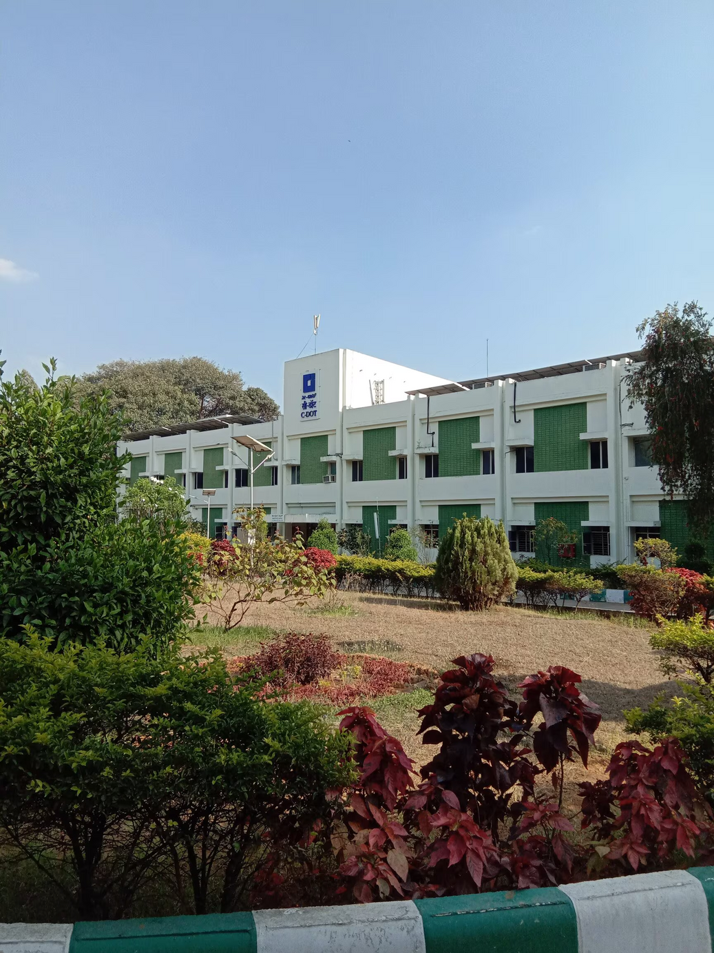
Industry
Project.
2025
CDOT: A Government of India telecom R&D organization.
Focus: Telecom innovation and rural digital infrastructure
Internship scope: Real-world application of LLMs on edge devices under CDOT guidance.
COLLABORATION WITH CDOT
01

Slide 5
Internship
Project.
2025
OBJECTIVE
01
Enable deployment of large language models on resource-constrained edge devices
COMPARATIVE STUDY ON QUANTIZED AND NON-QUANTIZED MULTI-AGENT LLMS?
02

Slide 6
Internship
Project.
2025
OBJECTIVE
01
Enable deployment of large language models on resource-constrained edge devices
COMPARATIVE STUDY ON QUANTIZED AND NON-QUANTIZED MULTI-AGENT LLMS?
02
Evaluate the effectiveness of multi-agent collaboration in QA tasks
02

Slide 7
Internship
Project.
2025
OBJECTIVE
01
Enable deployment of large language models on resource-constrained edge devices
COMPARATIVE STUDY ON QUANTIZED AND NON-QUANTIZED MULTI-AGENT LLMS?
02
Evaluate the effectiveness of multi-agent collaboration in QA tasks
03
Optimize and compare LLM performance using full-precision and INT8 quantized models
02

Slide 8
A
Designation: Student Trainee
D
Built an evaluation pipeline using gRPC for communication.
OVERVIEW
B
Designed a modular architecture for deploying LLMs on edge devices.
E
Utilized CUDA and Jetson Nano to support quantized model deployment.
ROLES AND RESPONSIBILITIES
06
C
Integrated Phi-2, Pythia-1B, and LLaMA-3.2-1B in a multi-agent setup.
F
Ran model performance tests and documented key insights and results.
Roles
Responsibilities
2025
03

Slide 9

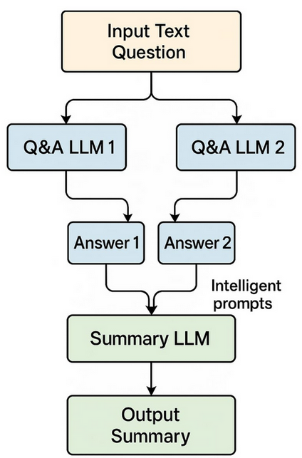

Who discovered gravity?

Slide 10
While the concept of gravity existed earlier, Isaac Newton formulated the law of universal gravitation in the 17th century, mathematically describing the gravitational force between objects.
Sir Isaac Newton discovered gravity when he observed an apple falling from a tree and began to think about the force pulling objects toward the Earth.

Slide 11
Isaac Newton is credited with discovering gravity by formulating the law of universal gravitation after observing objects falling to Earth, such as an apple. His work provided a scientific explanation for the force that attracts objects toward one another.

Slide 12
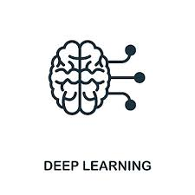
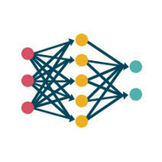

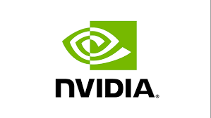


TECHNICAL EXPOSURE & TOOLS
Deep Learning
Neural Networks
01
02
Project.
gRPC Comn.
Hardware : Jetson Orion , A100 GPU
03
04
Quantization
Multi-Agents
05
06
leaarnings
04
04

Slide 13
KEY LEARNINGS
Is a multi-agent system always ideal?
Advantages: Task specialization, modularity, parallelism, improved accuracy
Limitations: Memory usage, power demand, system latency on edge devices
01
Internship
Learnings
05

Slide 14
KEY LEARNINGS
Is a multi-agent system always ideal?
Advantages: Task specialization, modularity, parallelism, improved accuracy
Limitations: Memory usage, power demand, system latency on edge devices
Why quantized models perform similarly to base models
Core features preserved during INT8 quantization
01
02
Internship
Learnings
05

Slide 15
KEY LEARNINGS
Is a multi-agent system always ideal?
Advantages: Task specialization, modularity, parallelism, improved accuracy
Limitations: Memory usage, power demand, system latency on edge devices
Why quantized models perform similarly to base models
Core features preserved during INT8 quantization
01
02
Internship
Do smaller or quantized models outperform larger ones?
Domain-specific tuning of small models can outperform large general-purpose models
Learnings
03
05

Slide 16
KEY LEARNINGS
Is a multi-agent system always ideal?
Advantages: Task specialization, modularity, parallelism, improved accuracy
Limitations: Memory usage, power demand, system latency on edge devices
Why quantized models perform similarly to base models
Core features preserved during INT8 quantization
01
02
Internship
Do smaller or quantized models outperform larger ones?
Domain-specific tuning of small models can outperform large general-purpose models
Why INT8 models have slower token throughput
Overhead from dequantization
Poor INT8 kernel optimization compared to FP16/BF16
03
04
Learnings
05

Slide 17
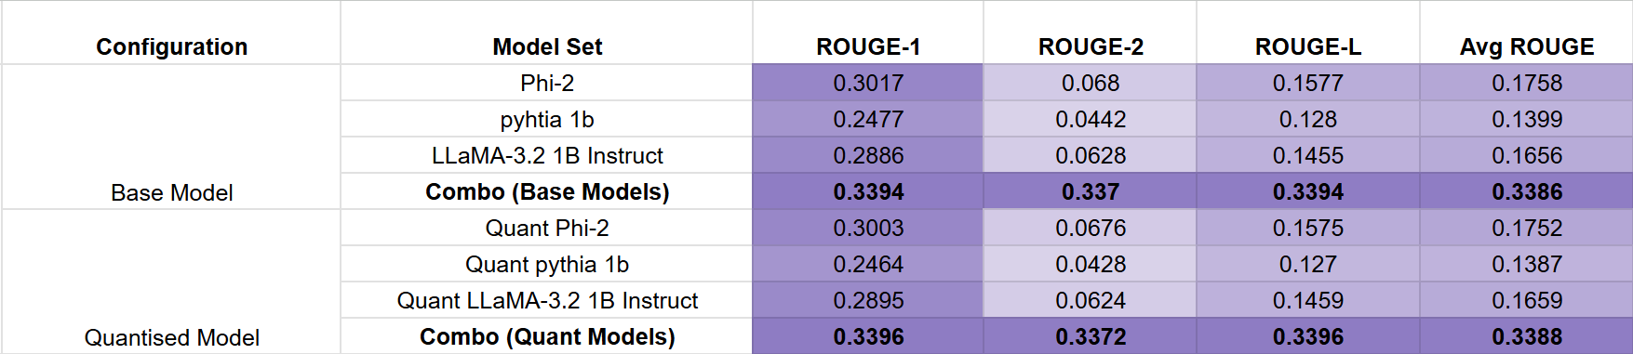
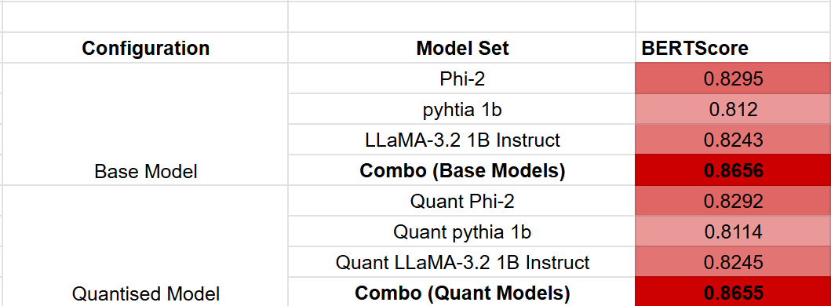
RESULTS
Internship
Learnings

Slide 18
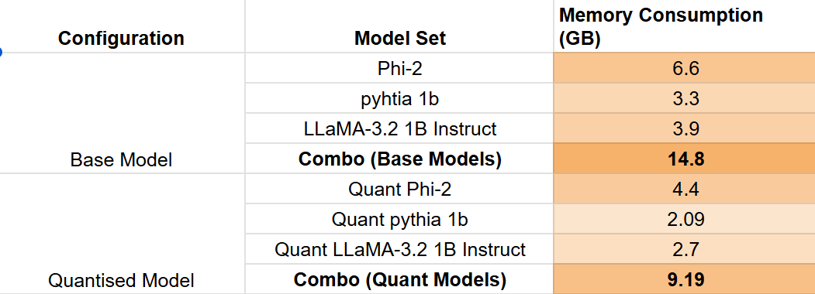
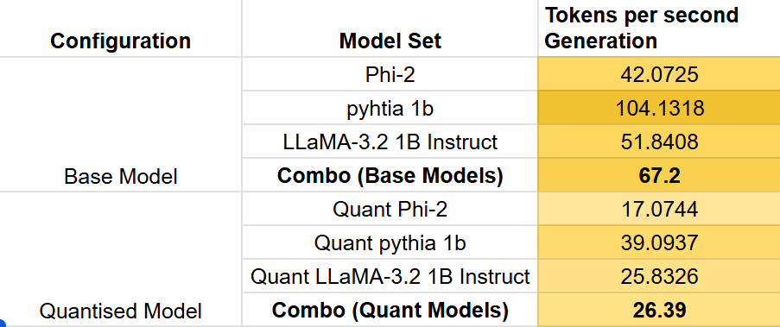
RESULTS
Internship
Learnings

Slide 19
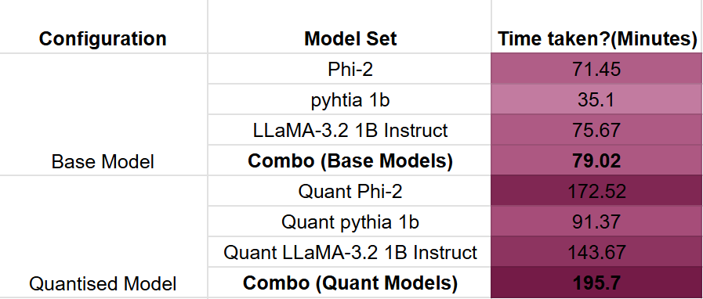
RESULTS
Internship
Learnings

Slide 20
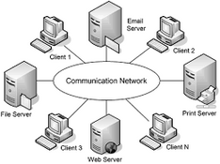
CHALLENGES
Introduction to Distributed Computing
01
Internship
Challenges
06
04

Slide 21

CHALLENGES
Introduction to Distributed Computing
Handling large models in limited computation hardware
01
02
Internship
Challenges
06
04

Slide 22
CHALLENGES
Introduction to Distributed Computing
Handling large models in limited computation hardware
01
02
Internship
Networking with gRPC
03
Challenges
06
04

Slide 23
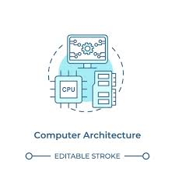
CHALLENGES
Introduction to Distributed Computing
Handling large models in limited computation hardware
01
02
Internship
Networking with gRPC
Quantization issue with different type of computer architecture
03
04
Challenges
06
04

Slide 24
Internship
Project.
2025
01
Addressed Technical Challenges: Applied efficient communication methods and modular design to support distributed computing.
CONCLUSION
02
Enhanced Model Efficiency: Implemented optimization techniques to enable large model deployment on edge devices.
03
Delivered Functional Outcomes: Developed and evaluated a robust multi-agent system with strong performance across model variants.
07

Slide 25
Internship
Project.
2025
FUTURE SCOPE
FUTURE SCOPE
DYNAMIC WORKFLOWS:
PRECISION OPTIMIZATION
Leverage adaptive agent selection and reinforcement learning for efficient multi-agent coordination.
Explore hybrid quantization techniques to balance speed, memory, and accuracy.
EDGE APPLICATIONS
SOCIAL IMPACT
Extend the system to real-time use cases like IoT devices and voice assistants.
Enable energy-efficient, privacy-focused AI on low-cost devices, with potential for future research and partnerships.
08

Slide 26
THANK YOU
WRAPPING UP AND PARTING THOUGHTS
09

